Slide 1
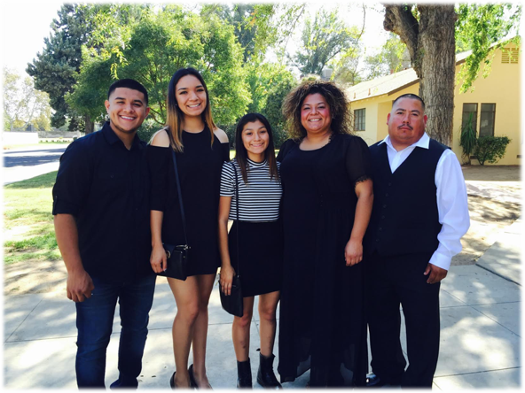
Cosme Hernandez
Class of 2016
Exit Interview

Slide 2
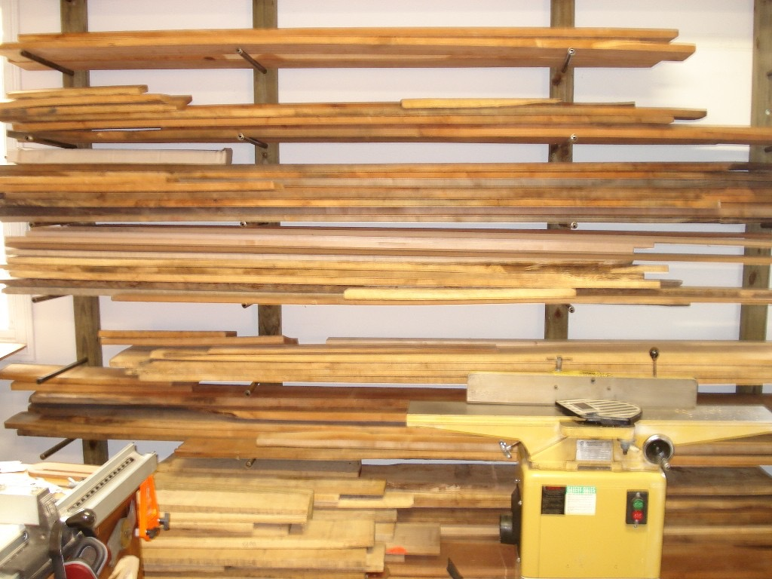
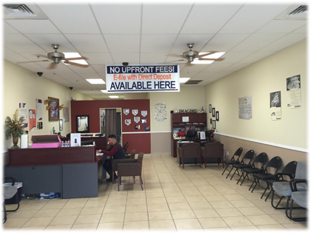
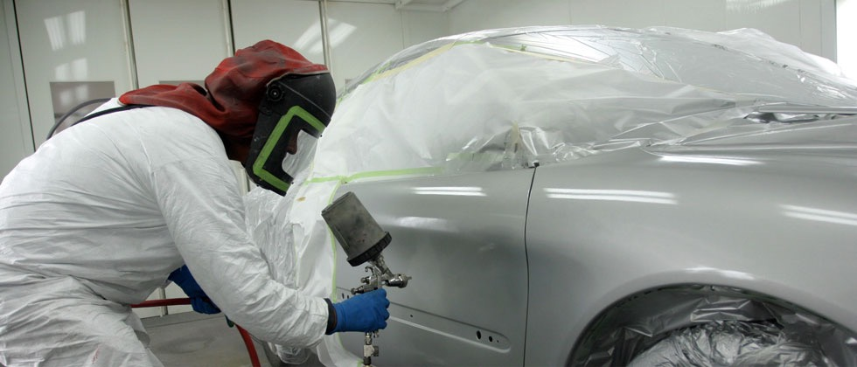
Preview
About Me
High School experience
Job Shadow
Pathway
Post- High School Plans

Slide 3
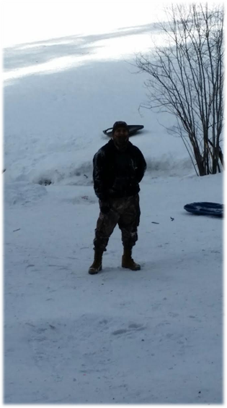
About ME
Cosme Hernandez
Born in Texas raised in California
2nd child out of 3
Creative, Out-going, Positive
1yr In High School Football, and Art Club

Slide 4
High School Experience
Cosme Hernandez
Football was very challenging and needed a lot of effort no slacking off or playing games when the time came for practice and game time
Art Club was not very interesting, stayed in the club for a few months and seen it going somewhere but lost interest
Very challenging to be in this kind of system, Honestly no time for slacking off and when you think there is, it comes right around and bites you. You need to stay on the top of things and not push it to the last minute or you will see yourself with a lot of stress on your shoulders
Honestly my biggest success will be passing geometry, and will be be able to provide for my child that’s on it’s way. One struggle that was my biggest struggle in my life was my Grandfather passing away, Everything Kind of fell apart and affected my school and my personal life.
I’ve learned so many new things about my self and being a student, if I actually put myself to the task and focus things can get done before its due or before its handed out. Not everything needs to be put off or pushed to the side, all you really need to do is focus and really look at the bigger picture.

Slide 5
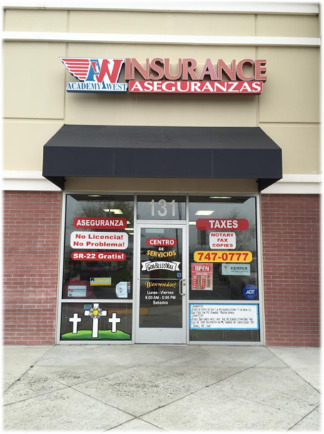
Job Shadow
Cosme Hernandez
Lupe Salas- Manager, tax agent
Skills Required
Fast pace
Positive atitude
Quick Learner
bilingual

Slide 6
Job Shadow
I chose this job because my mother will be leaving her businesses to me and I will need to prepare myself as much as possible, and to see how how this career works.
I’m interested in the because it involve my future and involves my family and I need this to be something stable and stress free and not see what my mother worked for so long and so hard see fall apart.
The experience was so interesting, very welcoming and felt like home, they really do know how to connect with the people and make them feel like your a friend and are welcomed, these qualities are not found very easy in a business.
Yes, I see myself working in this field later on in my life as my other dreams are being made and falling into place.

Slide 7
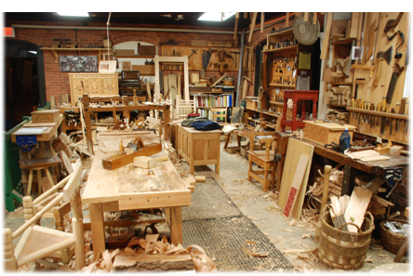
Pathway
Cosme Hernandez
My pathway is wood shop i pursued this pathway because I'm very hands on and love working with them, wood is very interesting to work with, the curves and the detail you could do to wood is amazing catches my eye and gets m stuck and in love with it.
I see myself opening up another business with wood carpentry and building furniture for my home and for others as well.
To be very patient!!

Slide 8
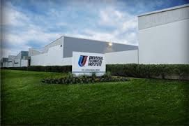
Post- High School Plans
Cosme Hernandez
I plan on attending UTI in Sacramento Ca. I’ve already got accepted and enrolled for August
My family is very excited that I will be going and are very supportive
Long term goal is to own my own business with my best friend

Slide 9
leaving LHS
Cosme hernandez
LHS has taught me to be a fast and independent learner and to always be on the ball
Responsibility, determination and perseverance are some of the traits that the PBS system has taught us as learners
Has taught me patience and many other qualities that I've mentioned

